Slide 1
Session 7– GitHub
Showcasing your work on your resume
Oct. 24 2024

Slide 2
Topics for Today
Announcements
GitHub
Next Sessions and Assignments – Great Topics

Slide 3
GitHub

Slide 4

What is GitHub
A really cute cat octopus?
Open-source repository for storing software code
Allows tracking of iterations (version control)
Collaboration tool
AND…A GREAT WAY TO SHOWCASE YOUR SKILLS TO EMPLOYERS

Slide 5

Getting Started
What is GitHub
GitHub and Git Basics Video
Learn more through:
LinkedIn Learning – Free to U of Iowa students
https://skills.github.com/ - Learn how to use GitHub with short interactive activities
Upload source code and project samples
Add GitHub public link to your resume

Slide 6
GitHub Page Samples
Create a repository
Kris Arens: https://github.com/kristinearens
Create a Website
Kris’ Sample: https://kristinearens.github.io/testpage-main/
Canny Li Page: https://mobius21.github.io/markdown-portfolio/
Zach McDaniel: https://zachmcdaniel.github.io/

Slide 7
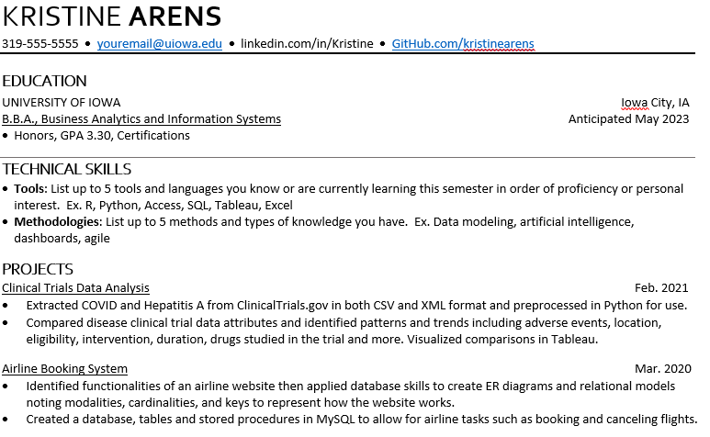
GitHub on Resumes
Showcase your work
Match repository to projects
Provide:
Code examples
Presentations
Data Analysis

Slide 8
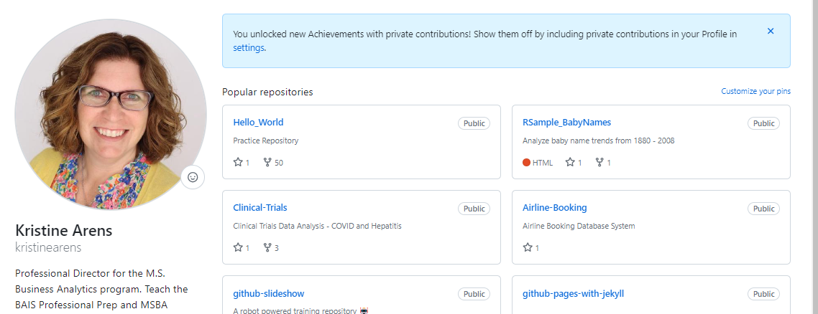
Let’s Take a Look
https://github.com/kristinearens

Slide 9

What’s Coming Up!

Slide 10


Next 2 Weeks
NEXT WEEK (Oct. 31): Jason Woodson and Jakob Anderson from Foresight Strategy – Discuss Consulting and Data Analytics
FINAL WEEK (Nov. 7): Industry Trends Discussion

Slide 11
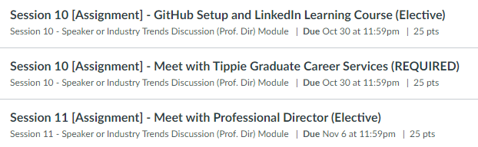
Remaining Options – 2 Elective, 1 Required

